Slide 1
AI-POWERED COLLECTIONS STRATEGY
Leveraging Agentic AI for Scalable, Fair, and Effective Debt Management at Geldium

Slide 2
How the AI-Powered Collections System Works
Customer Data Input The system receives real-time data about customers — such as age, income, credit utilization, payment history, and missed payments.
Predictive Risk Scoring A machine learning model analyzes this data to generate a risk score for each customer, predicting the likelihood of delinquency.
Decision Engine Based on risk scores and business rules, the system decides the best next step for each customer (e.g., reminder, deferral, escalation).
Automated Action Execution The chosen action is automatically delivered — like sending a personalized SMS or offering a repayment plan.
Learning Loop The system monitors how customers respond (e.g., whether they pay or ignore the message) and uses that feedback to improve future decisions.
Notes:
Prompts to try:
Generate a simple outline for an AI collections system workflow, including inputs, decision logic, action triggers, and learning loop.
List 3–5 key customer attributes that would be most predictive for collections decision-making, and explain why each one matters.
Suggest examples of business rules and AI-driven actions the system could use at different risk levels (e.g., low, medium, high risk).
Create a rough sketch or step-by-step description of how customer data flows through the system from intake to action.

Slide 3
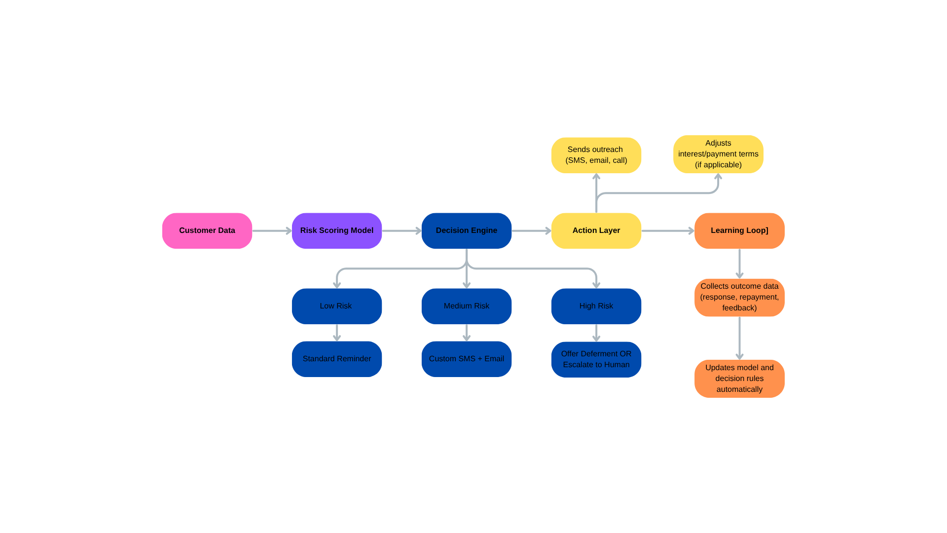
How the AI-Powered Collections System Works
Notes:
Prompts to try:
Generate a simple outline for an AI collections system workflow, including inputs, decision logic, action triggers, and learning loop.
List 3–5 key customer attributes that would be most predictive for collections decision-making, and explain why each one matters.
Suggest examples of business rules and AI-driven actions the system could use at different risk levels (e.g., low, medium, high risk).
Create a rough sketch or step-by-step description of how customer data flows through the system from intake to action.

Slide 4
Role of Agentic AI
Agentic AI makes smart decisions autonomously and adapts over time. Here’s how it functions in the collections system:
Autonomous Tasks:
Deciding the right outreach strategy (e.g., text vs. call vs. email).
Adjusting frequency and tone of messages based on customer response.
Offering self-serve options for payment rescheduling.
Human Oversight Tasks:
Reviewing disputed or unusual cases.
Handling hardship requests with empathy.
Ensuring compliance with regulatory requirements.
Key point: The system doesn’t just follow rules — it learns, adapts, and makes decisions based on context and outcomes, like a human agent.
Notes:
Prompts to try:
Generate a simple outline for an AI collections system workflow, including inputs, decision logic, action triggers, and learning loop.
List 3–5 key customer attributes that would be most predictive for collections decision-making, and explain why each one matters.
Suggest examples of business rules and AI-driven actions the system could use at different risk levels (e.g., low, medium, high risk).
Create a rough sketch or step-by-step description of how customer data flows through the system from intake to action.

Slide 5
Responsible AI Guardrails
To ensure the system is fair, transparent, and compliant, these safeguards are built in:
Fairness Audits
Regularly test if the model treats all groups (e.g., age, income level) equally — and fix any bias.
Explainability
Use tools like SHAP to show why a customer was marked high-risk (e.g., missed 2 payments, high credit usage).
Make it easy for both staff and customers to understand.
Human Review Points
For high-impact actions (like denying assistance), a human must approve the decision.
Compliance Monitoring
Ensure the system follows laws like the GDPR, ECOA, and FCA — with audit trails and documentation.
Notes:
Prompts to try:
Generate a simple outline for an AI collections system workflow, including inputs, decision logic, action triggers, and learning loop.
List 3–5 key customer attributes that would be most predictive for collections decision-making, and explain why each one matters.
Suggest examples of business rules and AI-driven actions the system could use at different risk levels (e.g., low, medium, high risk).
Create a rough sketch or step-by-step description of how customer data flows through the system from intake to action.

Slide 6
Expected Business Impact
A. Business KPIs (Key Performance Indicators)
These are the measurable improvements Geldium can expect:
Reduction in 30+ day delinquency rates by 10–15% Through personalized, timely outreach based on risk scoring.
20–30% increase in collections efficiency Automation reduces manual workload and speeds up case handling.
Lower operational costs Less reliance on call centers; system automates reminders and decisions.
Faster resolution times Real-time decisioning accelerates customer response and recovery.
Scalability without additional headcount The system can manage 10,000+ accounts autonomously.
Notes:
Prompts to try:
Generate a simple outline for an AI collections system workflow, including inputs, decision logic, action triggers, and learning loop.
List 3–5 key customer attributes that would be most predictive for collections decision-making, and explain why each one matters.
Suggest examples of business rules and AI-driven actions the system could use at different risk levels (e.g., low, medium, high risk).
Create a rough sketch or step-by-step description of how customer data flows through the system from intake to action.

Slide 7
Expected Business Impact
B. Customer Outcomes
These are the qualitative benefits for customers and overall customer experience:
Fairer treatment for all segments Bias detection and human oversight ensure equitable outcomes.
More relevant and supportive interventions Customers receive help (like deferment options) based on actual risk, not assumptions.
Improved trust and transparency Customers understand why an action was taken and can appeal decisions.
Better long-term financial health Proactive, personalized support reduces default risk and stress for customers.
Notes:
Prompts to try:
Generate a simple outline for an AI collections system workflow, including inputs, decision logic, action triggers, and learning loop.
List 3–5 key customer attributes that would be most predictive for collections decision-making, and explain why each one matters.
Suggest examples of business rules and AI-driven actions the system could use at different risk levels (e.g., low, medium, high risk).
Create a rough sketch or step-by-step description of how customer data flows through the system from intake to action.

